Slide 1
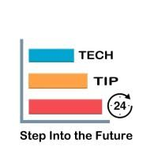
TECHTIP24 SQL PROJECT BY KOUSTAV BANERJEE

Slide 2
DETAILS OF THE PROJECT
PROJECT LINK-https://github.com/Koustav1997/Koustav-Projects
I USED THE EMPLOYEES DATABASE WHICH I DOWNLOADED FROM GIT HUB .THE DATABASE HERE CONSISTS OF DETAILS OF THE EMPLOYEES WWORKING IN AN ORGANIZATION.IN THIS PROJECT I FOUND OUT THE INSIGHTS FROM THE DATA PRESENT IN THE EMPLOYEES DATA BASE USING MY SQL WORKBENCH AND FOR THE VISUALIZATIONS I USED TABLEAU DESKTOP.
LINK OF THE DATABASE-https://github.com/datacharmer/test_db/blob/master/employees.sql

Slide 3
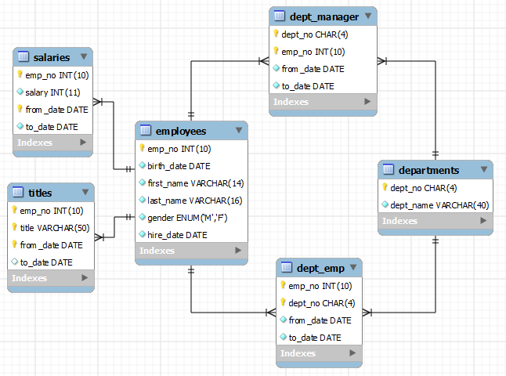
TABLES IN THE DATA-BASE

Slide 4
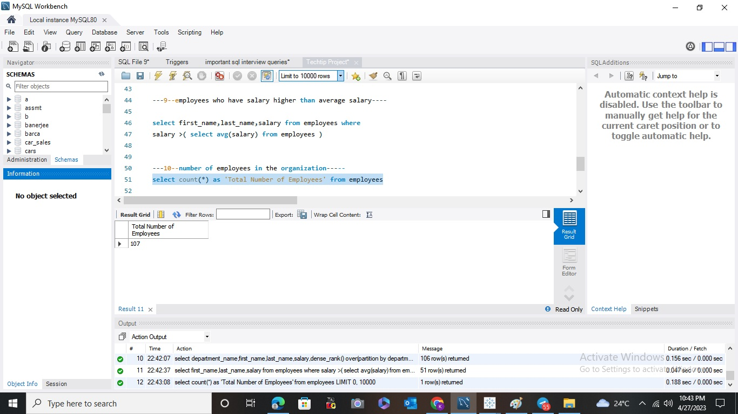
TOTAL NUMBER OF EMPLOYEES
TOTAL NUMBER OF EMPLOYEES IN THE ORGANIZATION=107

Slide 5
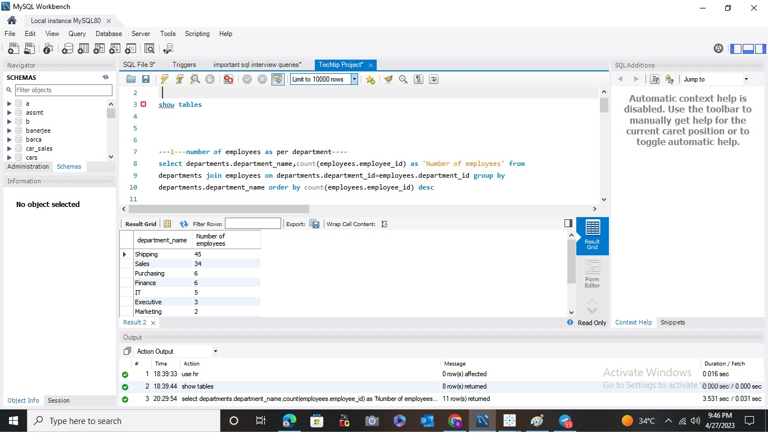
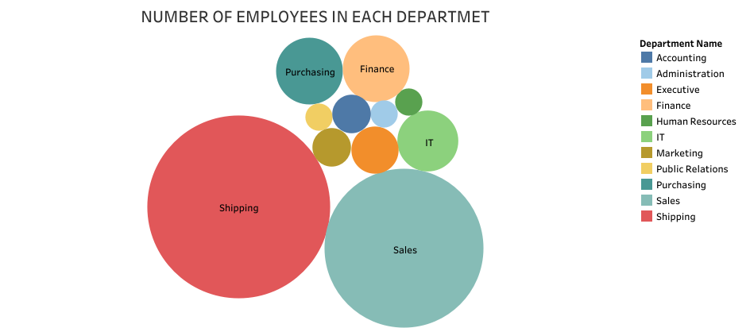
NUMBER OF EMPLOYEES IN EACH DEPARTMENT

Slide 6
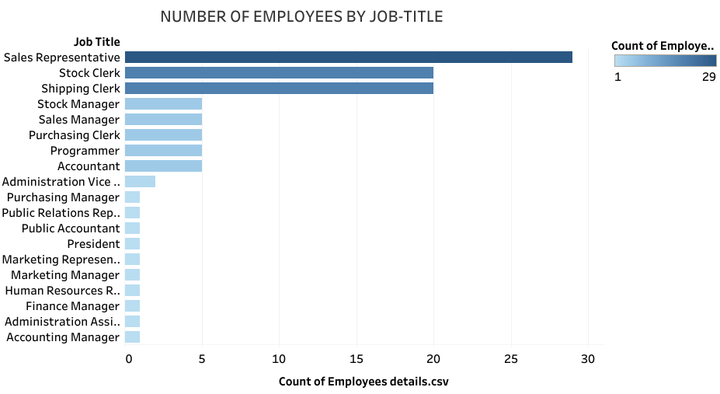
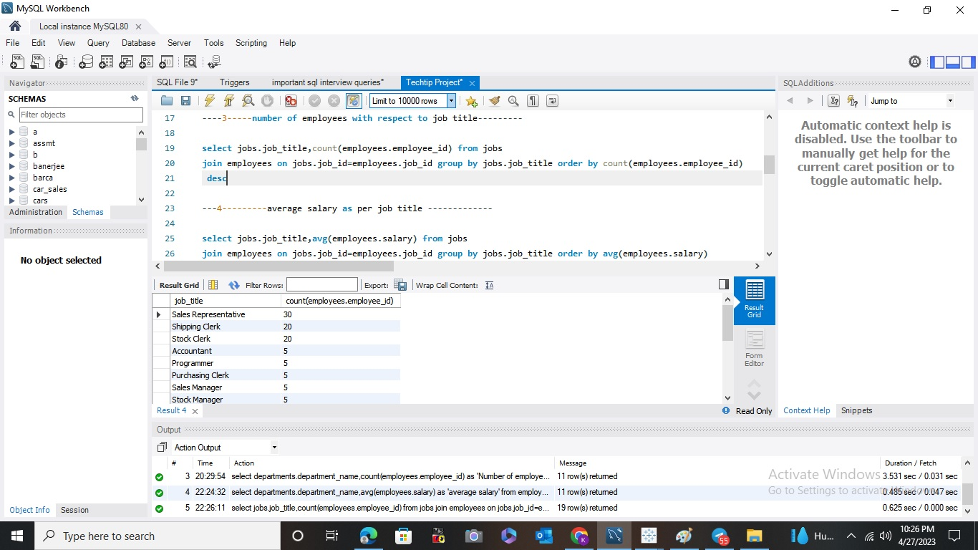
NUMBER OF EMPLOYEES BY JOB-TITLE

Slide 7
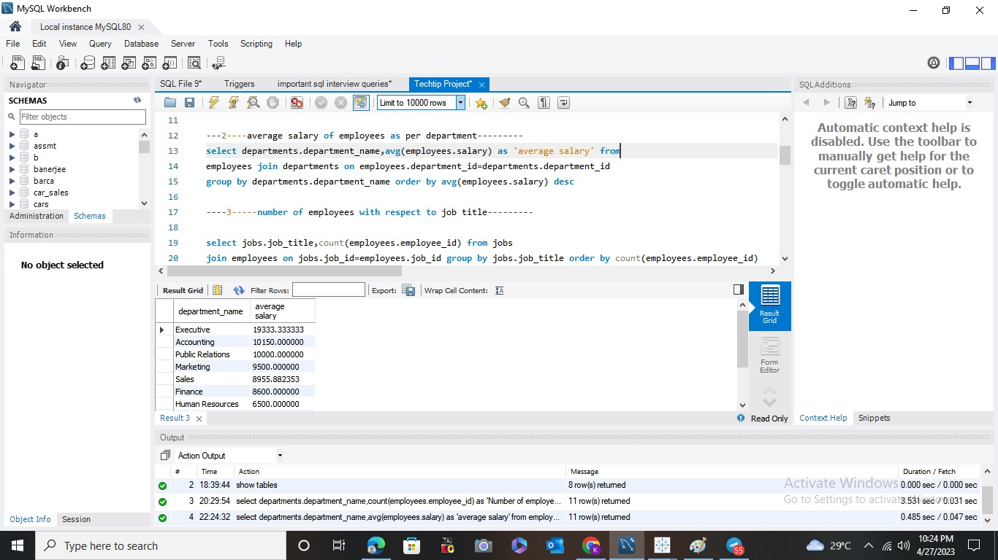
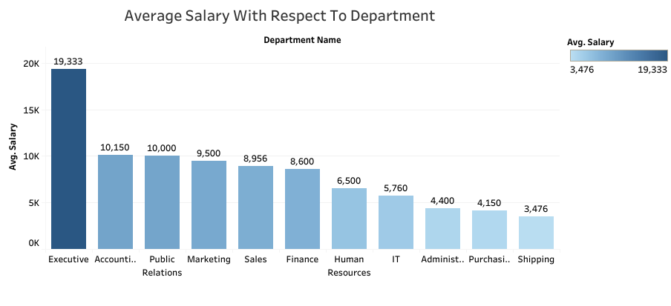
AVERAGE SALARY OF EACH DEPARTMENT

Slide 8
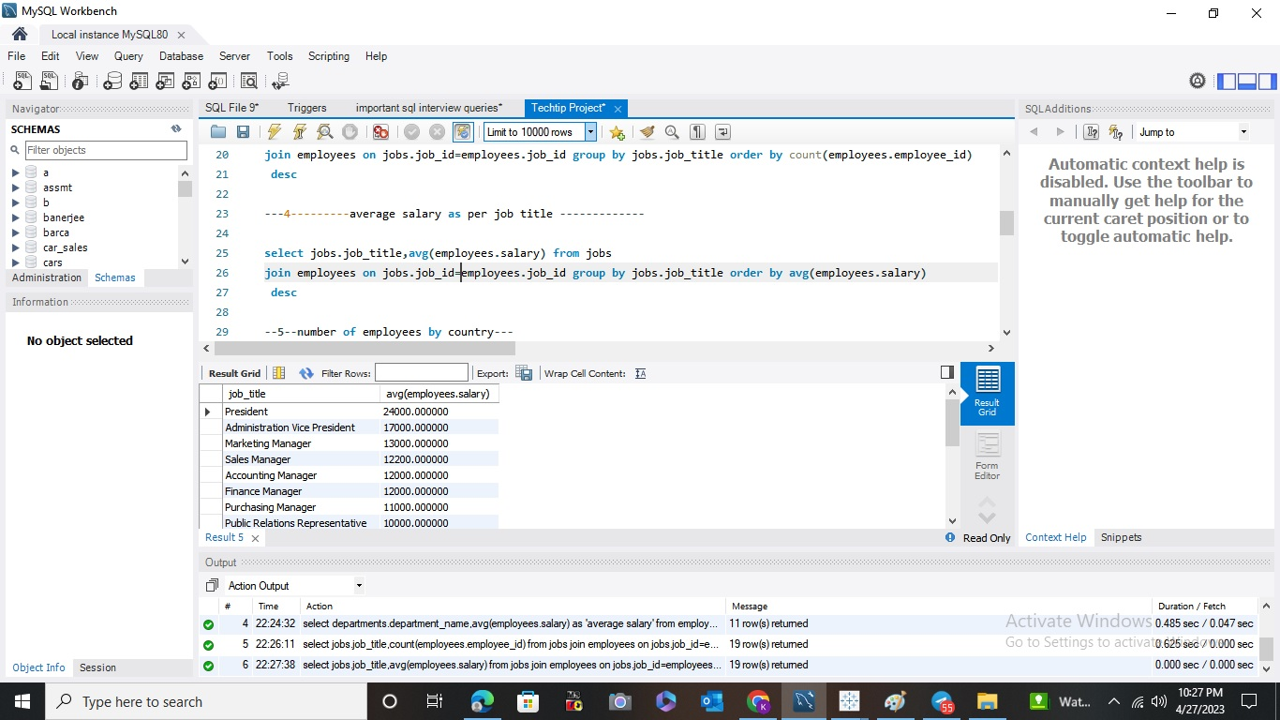
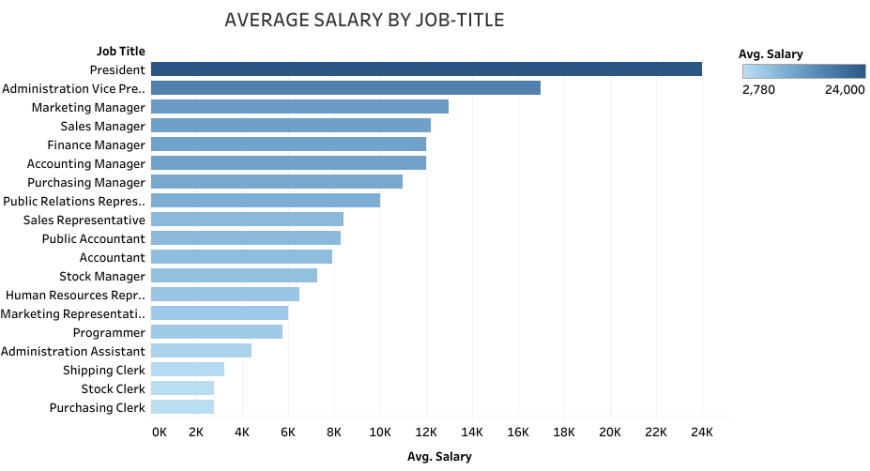
AVERAGE SALARY BY JOB-TITLE

Slide 9
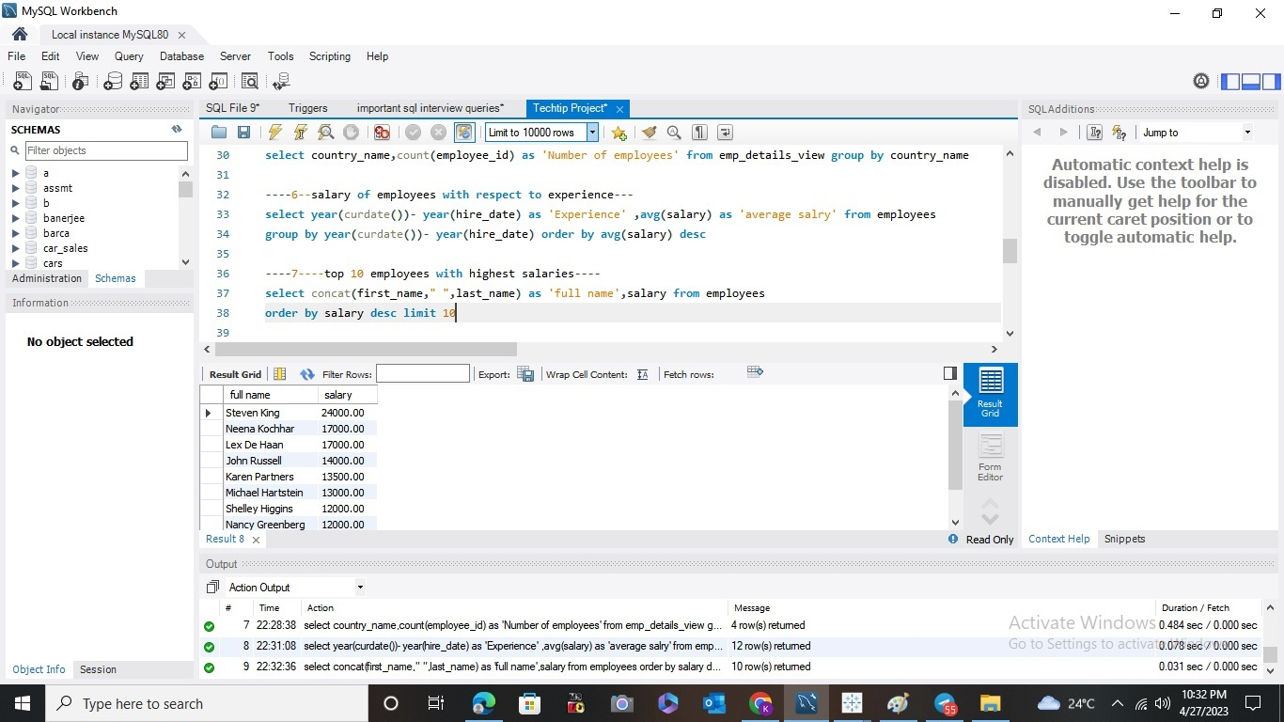
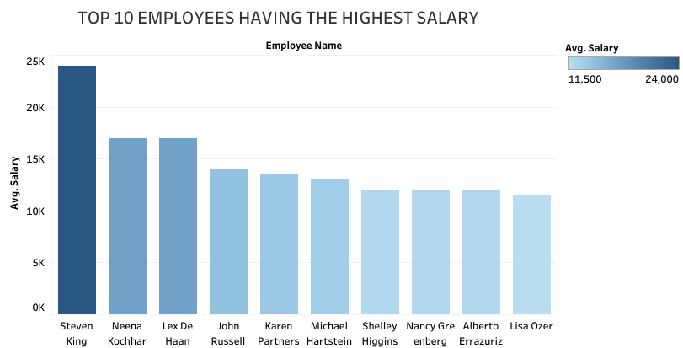
TOP 10 EMPLOYEES HAVING HIGHEST SALARY

Slide 10
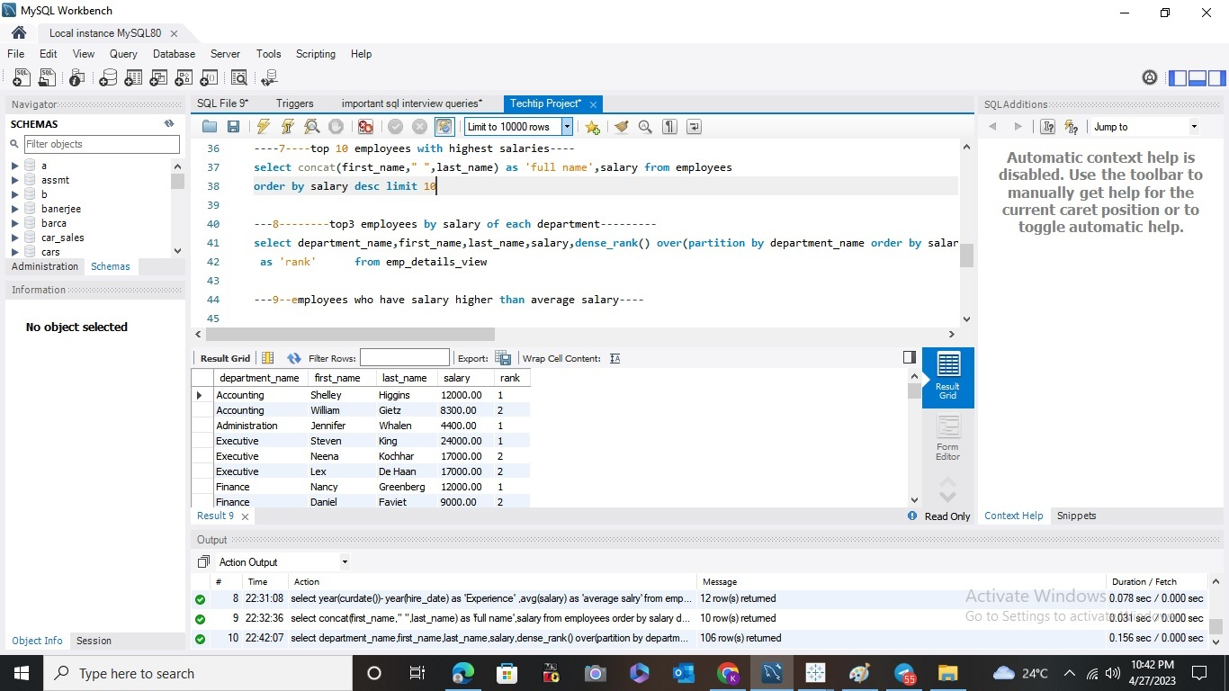
EMPLOYEES RECEIVING THE HIGHEST SALARY IN EACH DEPARTMENT

Slide 11
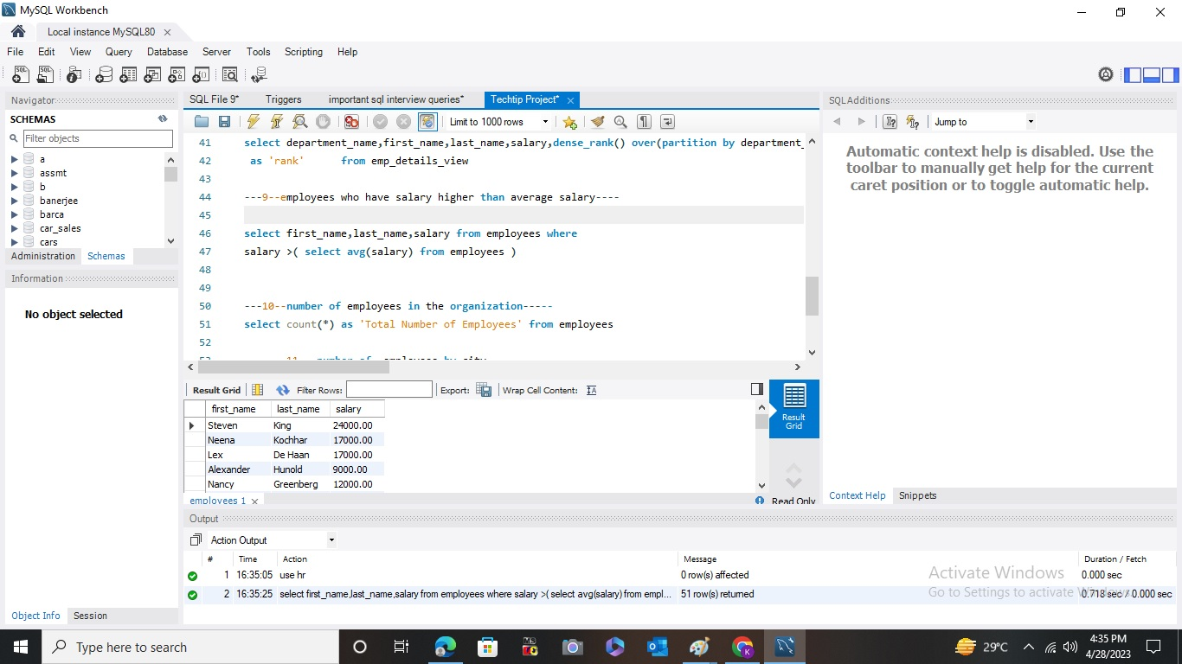
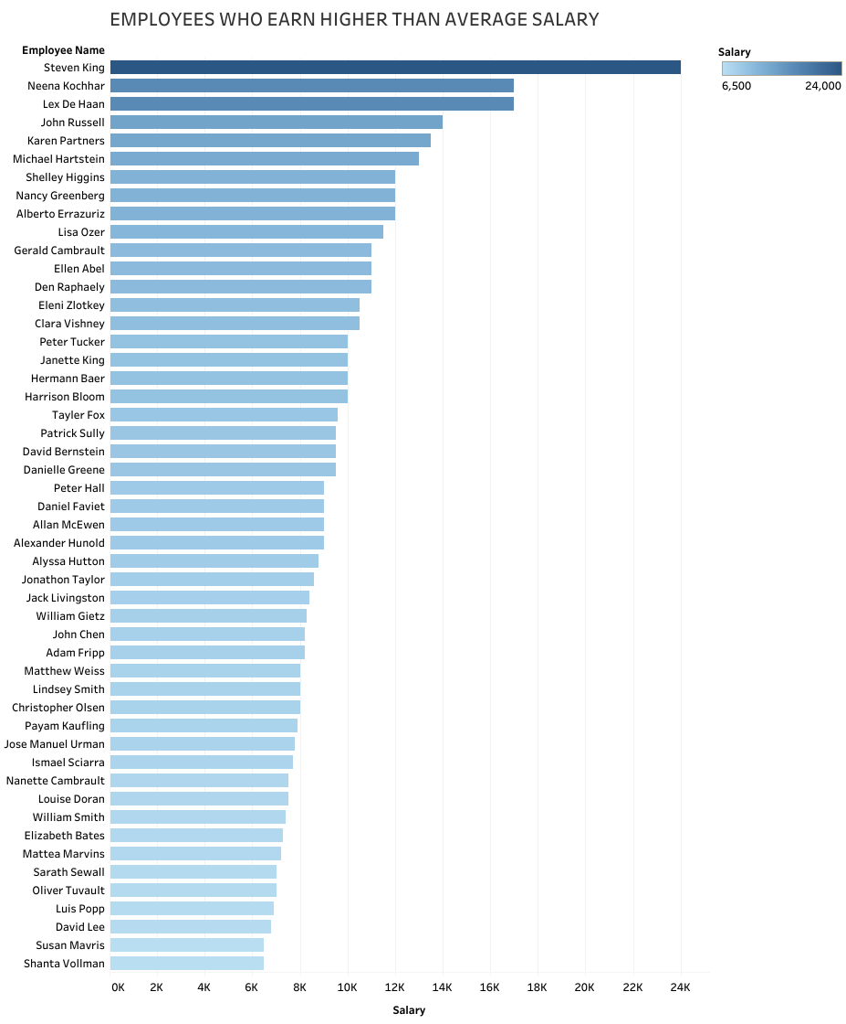
EMPLOYEES WHO EARN HIGHER THAN AVERAGE SALARY

Slide 12
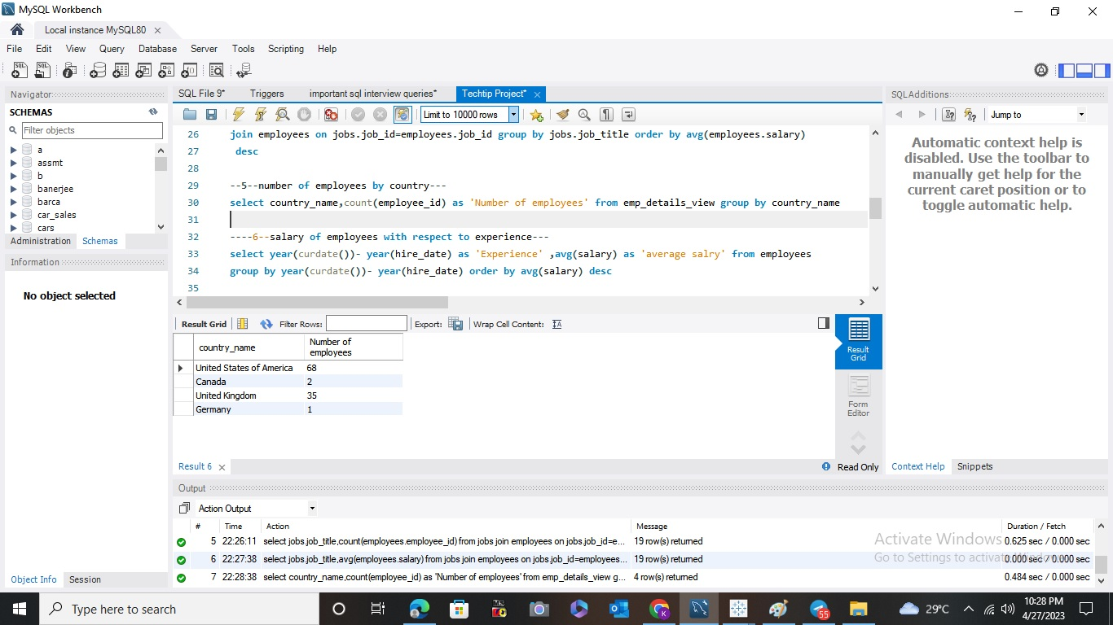
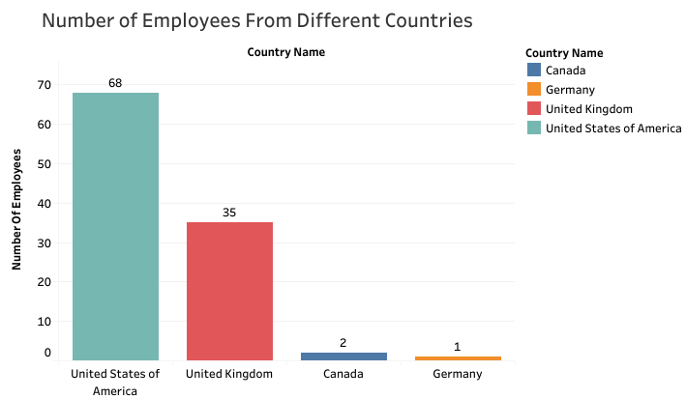
NUMBER OF EMPLOYEES FROM DIFFERENT COUNTRIES

Slide 13
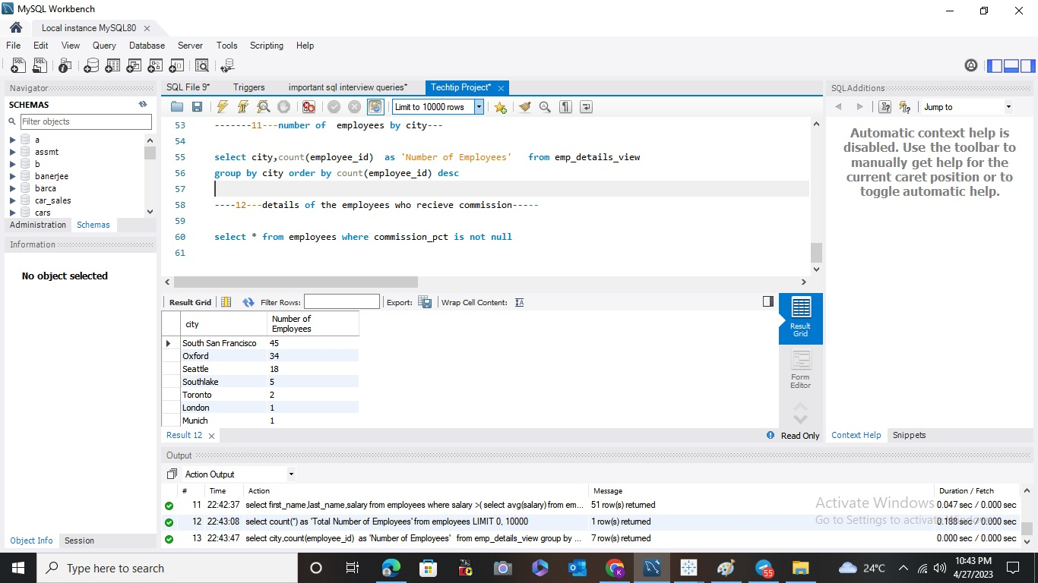
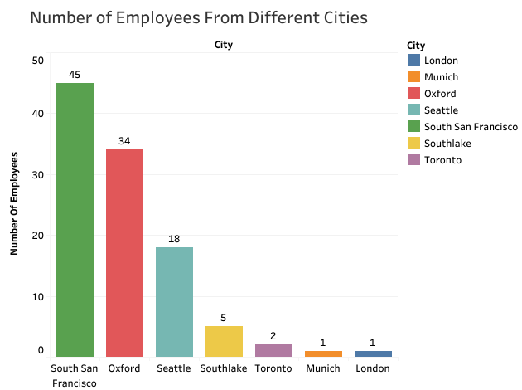
NUMBER OF EMPLOYEES FROM DIFFERENT CITIES

Slide 14
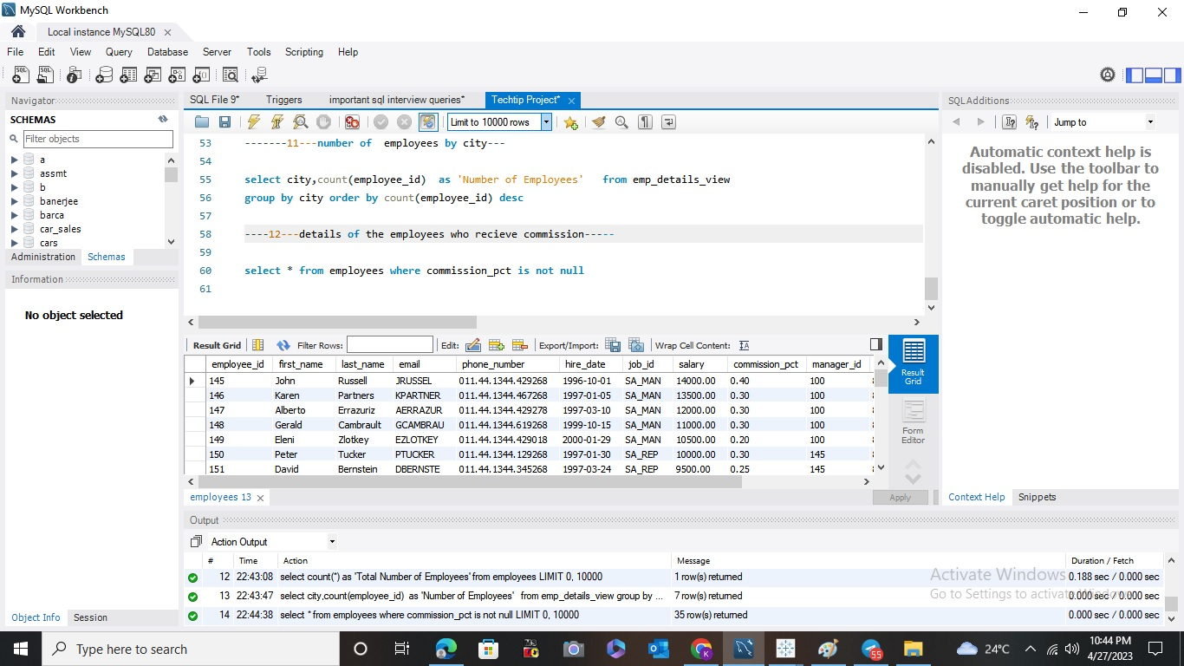
EMPLOYEES WHO ARE RECEIVING COMMISSION

Slide 15
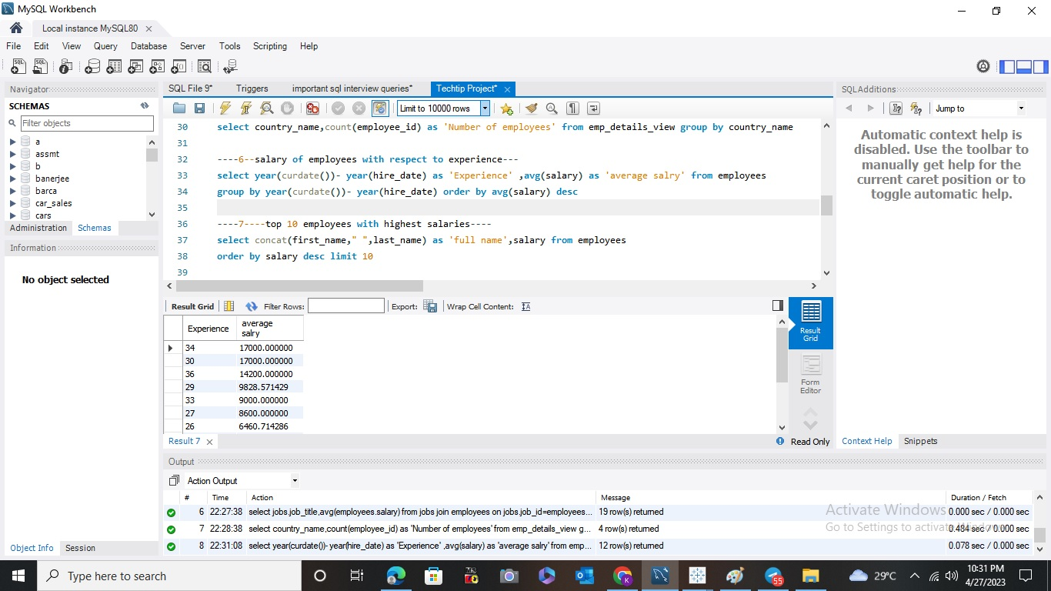
AVERAGE SALARY OF EMPLOYEES WITH EXPERIENCE

Slide 16
FINAL INSIGHTS
MOST OF THE EMPLOYEES OF THE ORGANIZATION ARE IN SHIPPING AND SALES DEPARTMENT
EMPLOYEES IN EXECUTIVE AND ACCOUNTING DEPARTMENT RECEIVE MORE SALARY THAN EMPLOYEES IN OTHER DEPARTMENTS
MOST OF THE EMPLOYEES ARE LIVING IN USA AND UK
EMPLOYEES HAVING MORE EXPERIENCE EARN MORE THAN EMPLOYEES WITH LESS EXPERIENCE
MOST EMPLOYEES ARE HAVING THE JOB TITLE SALES REPRESENTATIVE ,SHIPPING CLERK AND STOCK MARKET CLERK
Steven king,neena kocchar, lex de haan are the highest paid employees

